Slide 1
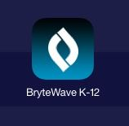
FollettShelf Brytewave (K-12)
App for ipad, iphone, ipod touch
Android, Nook HD and Nook HD+

Slide 2
Step One: Download the App (with parent permission)

Slide 3
The first time you open
the App, you will need to
login following these directions.
They will be printed in the Monday Mail.

Slide 4
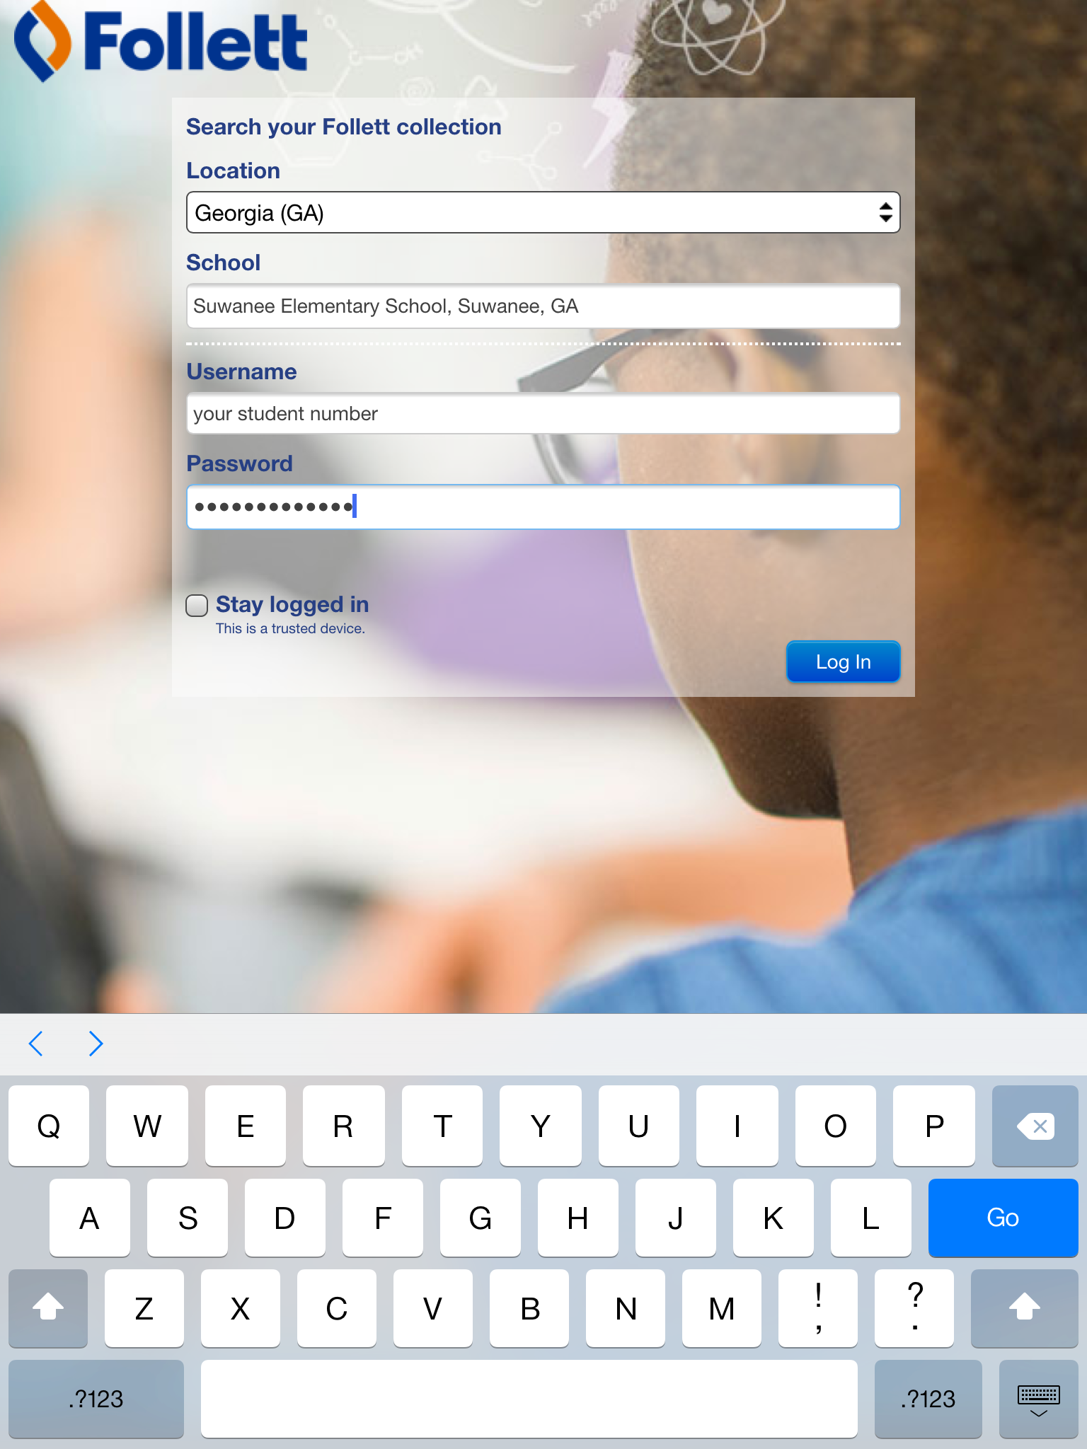
You should check this box if this is a secure device, so you won’t have to keep logging in each time you access your account
Type your password here

Slide 5
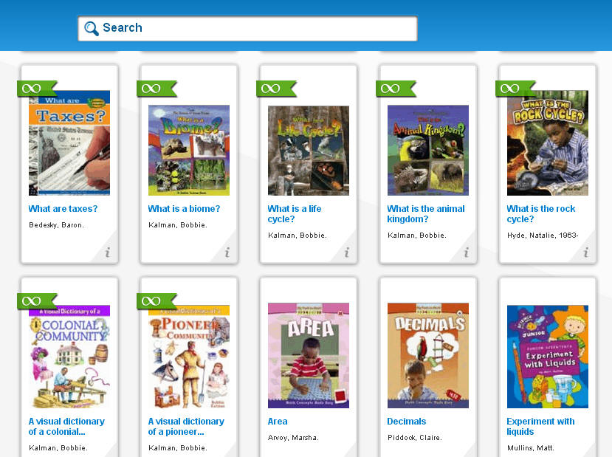
Unlimited – everyone can open at the same time
Limited to 5 copies or less

Slide 6
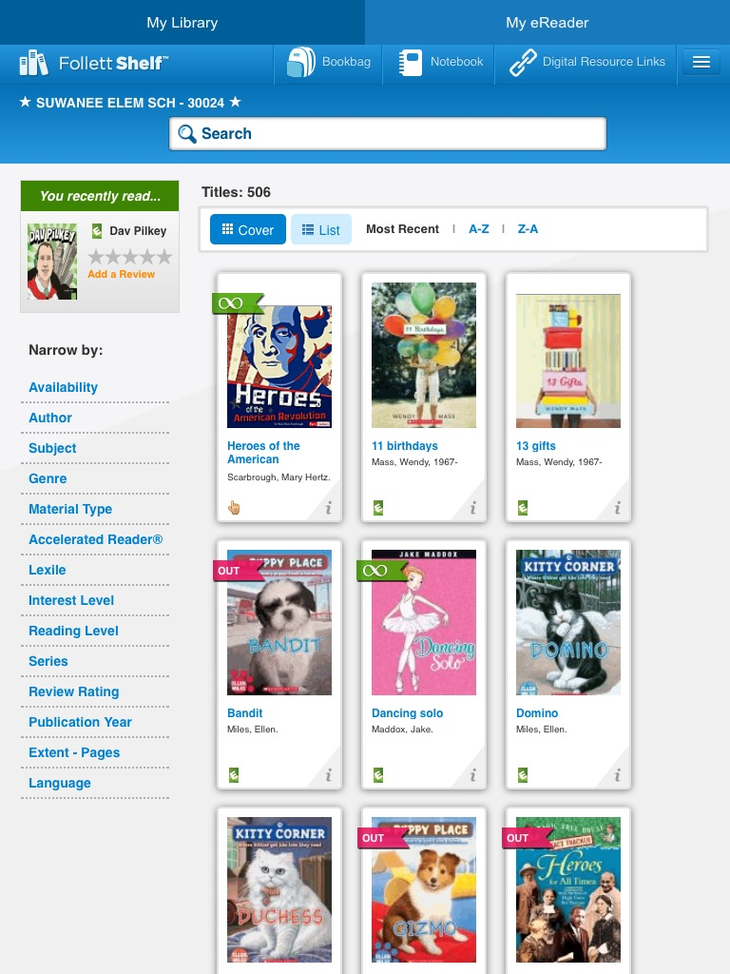
There are many ways to search for books

Slide 7
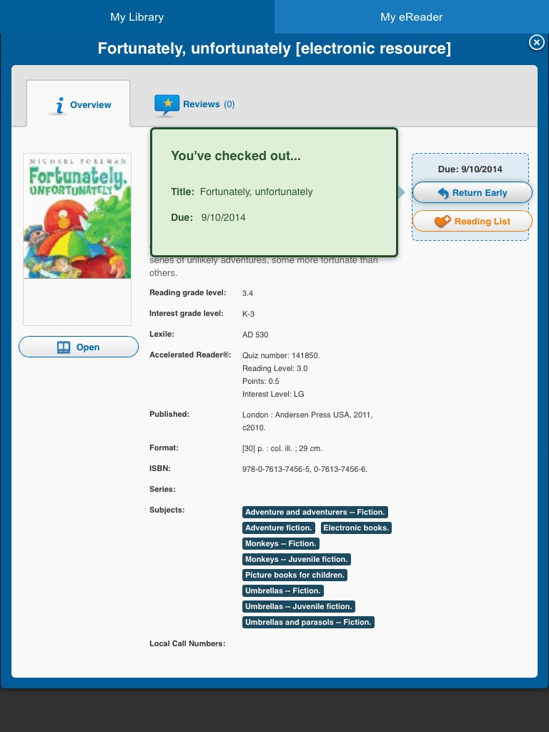
When you have books checked out, you can see them under the “i”.

Slide 8
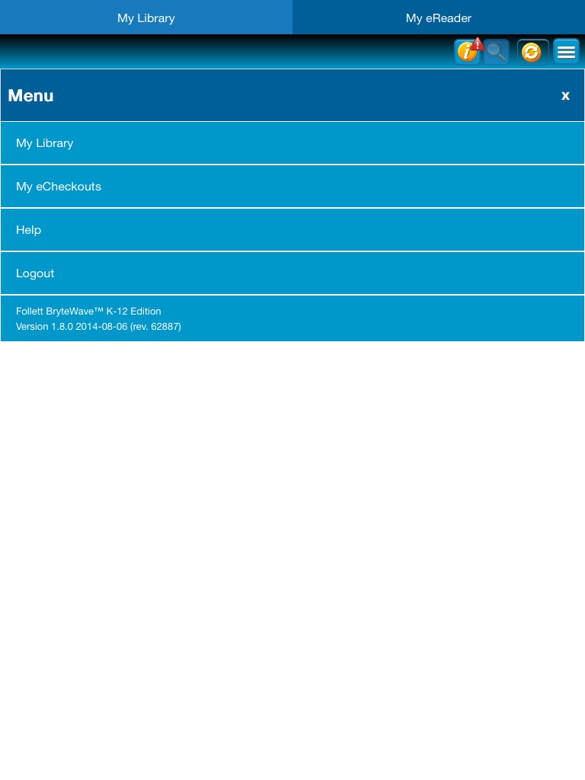

Slide 9
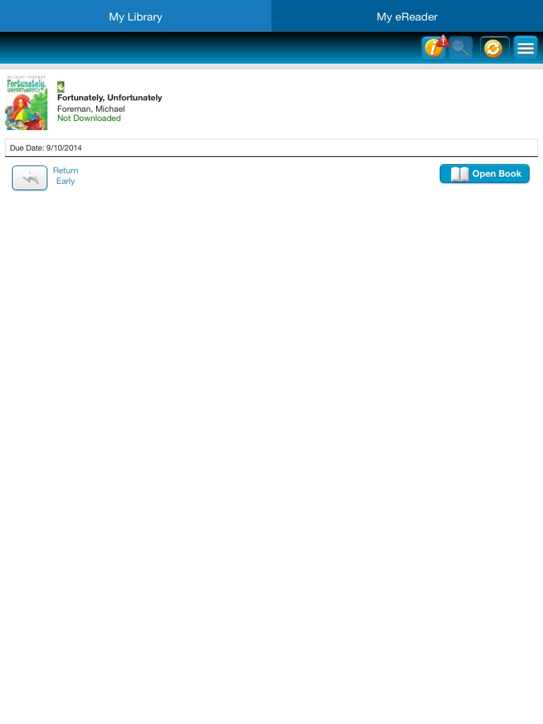
Click here to return a book early.

Slide 10
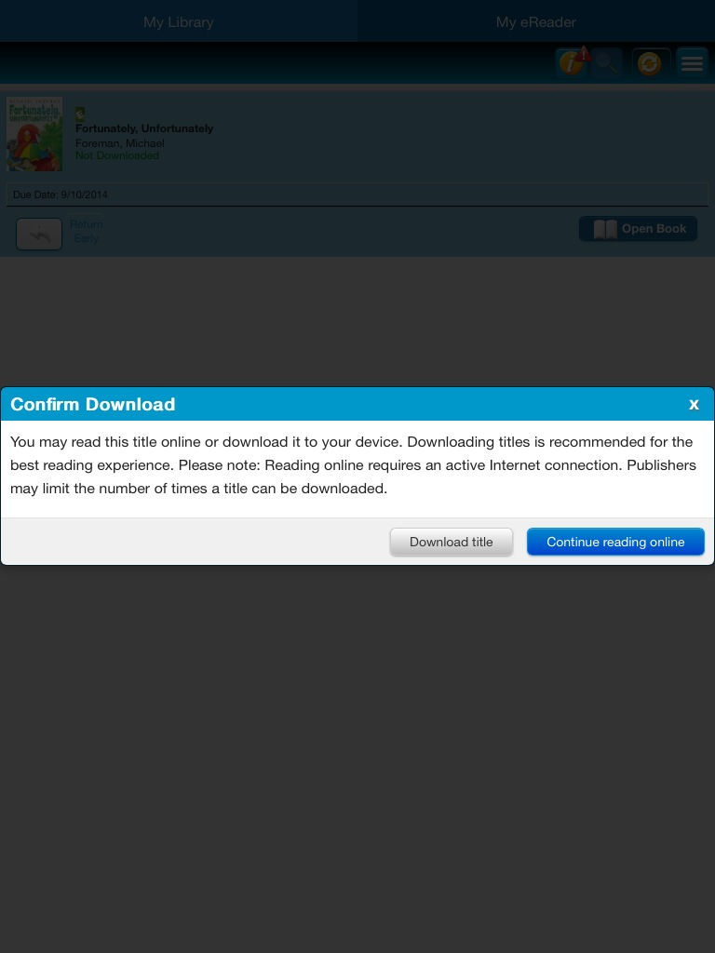
You may “download” the book to read it “offline”.

